Slide 1
Python Collections: Counter
DVT101 – Lecture 30
- By Dataverse Tutorials

Slide 2
What is Counter in Python?
Definition of Counter
Part of collections module
Subclass of dictionary
Used for frequency counting

Slide 3
Why Counter is Needed
Manual counting is lengthy
Avoids loops and conditions
Faster frequency analysis
Cleaner syntax

Slide 4
Where Counter is Used
Word frequency in text
Vote counting systems
Log and event analysis
Data preprocessing

Slide 5
How Counter Works Internally
Hash table based storage
Keys as elements
Values as counts
Auto-initialized missing keys

Slide 6
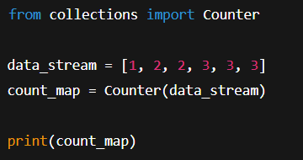
Creating Counter (Concept)
From list
From dictionary
From string
From keyword arguments

Slide 7
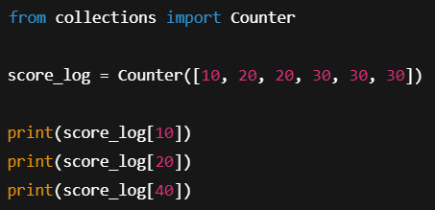
Accessing Counter Values
Key-based access
Default zero behavior
Safe lookups
Dictionary-like usage

Slide 8
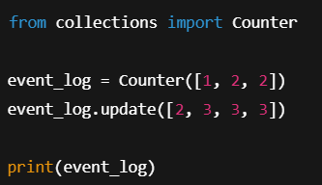
Updating Counter Data
Merging new data
Increasing counts
Adding new keys
Real-time data streams

Slide 9
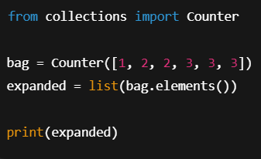
Exploring Counter Elements
Expanding back to list
Iterator behavior
Arbitrary order
Data reconstruction

Slide 10
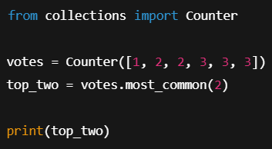
Finding Most Common Items
Ranking by frequency
Top-N logic
Useful for analytics
Recommendation systems

Slide 11
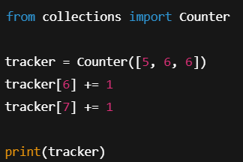
Incrementing Individual Counts
Direct value modification
Auto-creation of new keys
Tracking live events

Slide 12
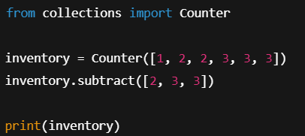
Subtracting Counts
Removing occurrences
Allowing negative values
Data correction logic

Slide 13
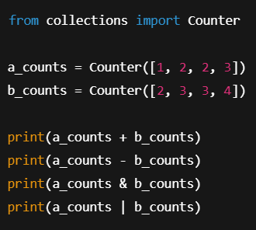
Arithmetic Operations on Counters
Addition of datasets
Difference between datasets
Intersection logic
Union logic

Slide 14
Counter vs Normal Dictionary
Less boilerplate code
Built-in analytics methods
Safer missing key handling

Slide 15
Performance Perspective
Faster than manual loops
Optimized hash lookups
Memory trade-offs

Slide 16
Real-World Industry Use Cases
NLP word counts
Fraud pattern detection
User behavior analysis

Slide 17
Common Mistakes
Misinterpreting negative values
Using for huge streams without limits
Forgetting Counter is mutable

Slide 18
Best Practices
Clean data before counting
Use most_common wisely
Combine with filtering

Slide 19
Career Relevance
Data Analyst dashboards
ML feature engineering
Backend analytics

Slide 20
When NOT to Use Counter
Ordered sequence required
Extremely large datasets
Real-time streaming at scale

Slide 21
Summary & Key Takeaways
Fast frequency counting
Cleaner than dict loops
Powerful analytics helper

Slide 22


